Slide 1
Quantum Cryptography
FOR SMART GRIDS
P.S. Abhiram ->BL.EN.U4CSE22140
Pranav Gokhale ->BL.EN.U4CSE22143
Surya Kausthub ->BL.EN.U4CSE22287

Slide 2
MOTIVATION
Rapid Digitalization: Increasing reliance on smart grids due to digitalization of energy systems.
Cybersecurity Risks: Growing concerns about cybersecurity vulnerabilities in smart grids.
Quantum Computing Threat: Traditional encryption may become vulnerable with the advent of quantum computing.
Quantum Cryptography: Leverages principles of quantum mechanics for superior security.
Quantum Key Distribution (QKD): Promises unprecedented security in key distribution.
Research Focus: Investigating the application of QKD in smart grids to enhance security and resilience against future cyber threats.

Slide 3
PROBLEM STATEMENT
As smart grids grow more complex and digital, they face increasing cyber threats. Traditional cryptography is vulnerable to future quantum computer attacks, which could compromise grid security. Quantum Key Distribution (QKD) offers unbreakable encryption, but its integration into smart grids, which require real-time communication, is under-researched. This project aims to explore how quantum cryptography can secure smart grid communication.
Example Scenario:
In a smart grid, components like power plants and smart meters communicate using classical encryption. A quantum computer could break this encryption, exposing the system to attacks. Using QKD would detect any interception, greatly improving grid security. This research simulates such a system to evaluate quantum cryptography's effectiveness, using Cisco Packet Tracer.

Slide 4
INTRODUCTION
Smart Grid Integration: Utilizes advanced communication technologies and IoT devices for efficient electricity management.
Cybersecurity Vulnerabilities: Increased connectivity heightens the risk of cyberattacks on smart grids.
Quantum Computing Threat: Traditional cryptographic methods may become obsolete as quantum computing advances.
Quantum Cryptography: Explores Quantum Key Distribution (QKD) as a novel approach to secure smart grid communication.
Research Focus: Evaluating the feasibility, performance, and integration of quantum cryptography in smart grid infrastructures.

Slide 5
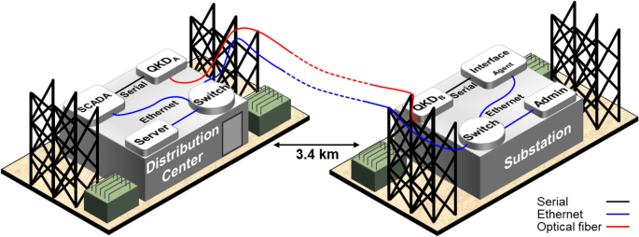
NETWORK DESIGN FOR
QUANTUM-ENHANCED SMART GRID

Slide 6
LITERATURE REVIEW
Paper #1
In order to protect against quantum assaults, the study suggests two safe, lightweight data aggregation algorithms for smart grids that make use of t-times homomorphic encryption. These strategies reduce computational and transmission overhead while guaranteeing data integrity, secrecy, and efficiency. They provide strong protection against a range of threats and are intended for small- to medium-sized networks, such as smart cities and residential area networks. The usefulness of these approaches for actual smart grid applications is highlighted in the study.
Paper #2
The paper introduces a distributed privacy-preserving data aggregation scheme for smart grids with fine-grained access control. It employs homomorphic encryption, digital signatures, and distributed proxy re-encryption to ensure user privacy, data authenticity, and controlled access to the aggregated data. The scheme is designed to avoid single points of failure and is efficient enough for practical applications in real-world smart grids.

Slide 7
LITERATURE REVIEW
Paper #3
The paper presents a privacy-preserving scheme called 2D2PS for anonymous data sharing in smart grids, addressing privacy breaches with controlled anonymity and fine-grained access control. It introduces an authenticable pseudonym assignment method, proxy re-encryption, and data separation for secure data handling. The scheme is proven effective and lightweight through theoretical and experimental evaluations.
Paper #4
The article introduces EBDA, an edge blockchain-assisted scheme for privacy-preserving data aggregation in smart grids, using homomorphic Paillier encryption and one-way hash chains. EBDA enhances efficiency by reducing communication overhead and filtering false data, while ensuring privacy and resilience against network attacks. The architecture supports a two-level data aggregation process, demonstrating superior performance through theoretical analysis and simulations.

Slide 8
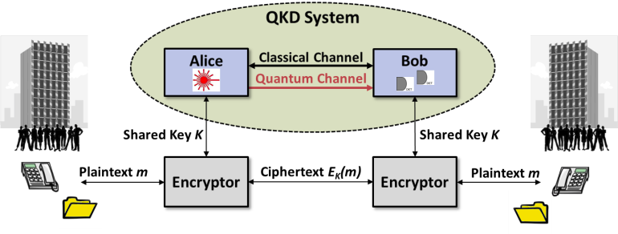
CHALLENGES OF EXISTING SYSTEMS
Vulnerability to Quantum Attacks: Traditional cryptographic methods can be easily broken by future quantum computers.
Our Solution: Quantum Key Distribution (QKD) offers unbreakable security, even against quantum-based threats.
Decentralized Grid Structure: Smart grids rely on distributed components like power plants, substations, and smart meters, making secure communication across locations difficult.
Our Solution: QKD enables secure key exchanges across decentralized components with instant detection of eavesdropping.

Slide 9
CHALLENGES OF EXISTING SYSTEMS
Scalability Issues: Implementing traditional cryptography at scale across large smart grids is resource-heavy and inefficient.
Our Solution: Simulating and testing scalable and efficient integration of Quantum Channels into existing smart grid infrastructures.
Lack of Secure Key Management: Traditional methods face challenges with secure key distribution and management, leaving systems exposed to key compromise.
Our Solution: QKD ensures the secure distribution of encryption keys without the need for physical transport or classical secure channels.

Slide 10
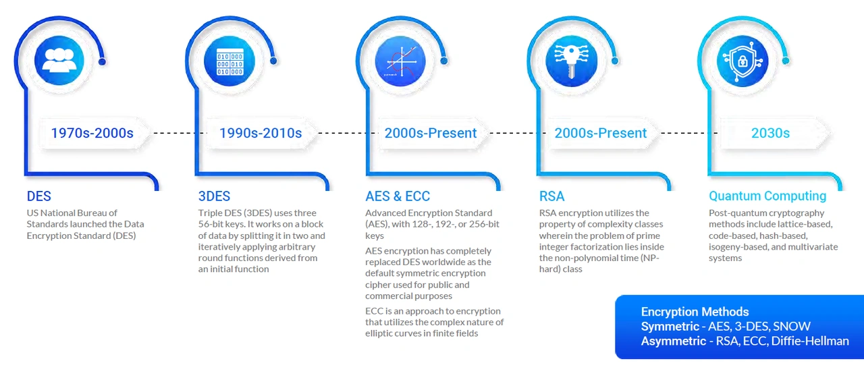
RESEARCH GAPS
Practical Implementation: There is limited research on the practical implementation and integration of QKD in smart grids.
Performance Evaluation: No comprehensive studies evaluate the performance impact (e.g., latency, scalability) of applying quantum cryptography to smart grid infrastructures.
Hybrid Solutions: Research is lacking on combining classical cryptographic methods with quantum cryptography to achieve both security and practicality.

Slide 11
OBJECTIVE
The primary objective of this research is to design and evaluate a quantum cryptographic system for smart grids. Specifically, the research aims to:
Investigate the feasibility of integrating QKD into smart grid communication networks.
Develop a hybrid cryptographic system combining classical and quantum methods for enhanced security.
Evaluate the performance of the quantum cryptographic system in terms of latency, key generation rate, and scalability.

Slide 12
METHODOLOGY
System Architecture :
Design a hybrid communication system combining QKD for key exchange and classical encryption for data transmission.
Connect smart grid components like smart meters, substations, control centers, and power plants.
Ensure end-to-end security.
QKD Implementation :
Implement QKD protocols (e.g., BB84) to generate and exchange keys securely.
Use quantum channels for key exchange to detect any interception instantly.
Integration with Classical Cryptography
Integrate QKD-generated keys with classical encryption algorithms (e.g., AES).
Ensure low latency for real-time communication and backward compatibility with existing infrastructure.

Slide 13
METHODOLOGY
Simulation with Cisco Packet Tracer:
Simulate the smart grid network using Cisco Packet Tracer.
Create QKD channels for key exchange and classical channels for encrypted data transmission.
Measure performance (latency, key refresh rates, security).
Performance Evaluation :
Test system resilience against quantum-based attacks (e.g., eavesdropping).
Assess the balance between real-time communication needs and enhanced security from QKD for practical smart grid implementation.

Slide 14
Thank you!

